Slide 1

Department of Computer Science and Engineering Project Work Phase 2 PROJECT TITLE : Tourism Recommendation System using Machine Learning
VISVESVARAYA TECHNOLOGICAL UNIVERSITY - BELAGAVI
Accredited by NBA
Guide Name :
Mr. Siddharth Bhatkande
Assistant Professor,
Dept. of CSE
Student Names :
Ms. Soumya Bailkeri (2BU19CS045)
Ms. Spoorti Koshavar (2BU19CS046)
Mr. Vivek Tigadi (2BU19CS057)
Mr. Shreyas Karadiguddi (2BU20CS406)
*
‹#›

Slide 2
Contents
1. Introduction
2. Literature Survey
3. Problem Statement
4. Objectives
5. Proposed Methodology
6. Implementation
7. Advantages and Disadvantages
8. Results and Snapshots
9. Conclusion
References
5/24/2023
‹#›

Slide 3
Introduction
In a world filled with countless possibilities, the task of finding the perfect travel experience can be overwhelming. That's where our project comes in. Through extensive research and the utilization of cutting-edge machine learning algorithms, we have developed a remarkable tourism recommendation system designed to simplify and enhance your travel planning process.
Our objective is simple: to provide personalized and tailored recommendations that suit your unique preferences, interests, and travel goals. By analyzing vast amounts of data, including user preferences, historical travel patterns, and destination characteristics, our system has the ability to accurately predict and suggest the ideal travel experiences for you.
Whether you're seeking a peaceful beach getaway, an adventure-filled mountain expedition, or a culturally enriching city tour, our system will be your trusted guide.
5/24/2023
*
‹#›

Slide 4
Literature Survey
S.NO | AUTHORS/YEAR | TITLE | OBSERVATIONS
1 | Bo Qiu and Wei (David) Year : 2021 | Machine Learning Based Short-Term Travel Time Prediction | Short-term TTP is a key component of the Advanced Travelers Information System (ATIS) in which in-vehicle route guidance systems (RGS) enable the generation of the shortest path for travelers, which connects the destinations and current locations. To identify whether the TTP is region-specific, further research is needed to replicate this study in other road categories using other types of data sources. Further results need to be achieved to compare all methods to further demonstrate whether the ensemble tree-based learning methods have better predictive accuracy in short-term TTP.
2 | Hend Alrasheed, Arwa Alzeer, Arwa Alhowimel,Nora shamer | A Multi - Level Tourism Destination Recommender System | The system incorporates two levels of recommendations as each user request undergoes two levels of recommendations. The first level involves providing the user with a set of destinations that matches her preferences (based on the preferences of similar users). The second level ranks the set of destinations based on the user preferences and constraints.
3 | Richa Sharma, Shalli Rani, Sarvesh Tanwar Year : 2019 | Machine Learning Algorithms for building Recommender Systems | This article presents an overview of the state-of-the-art Recommender systems with the prime focus on hybrid recommender systems. Further, different categories of hybridization models are studied, and the existing work is classified categorically based on the hybrid model they follow, and the Machine learning algorithm used.
‹#›

Slide 5
Contd…
S.NO | AUTHORS/YEAR | TITLE | OBSERVATIONS
4 | Charnsak Srisawatsakul, Waransanang Boontarig Year : 2020 | Tourism Recommender System using Machine Learning | The objective of this study is to develop the prototype of a tourism recommender system that automatically understands the user's preferences of their favorite tourist attractions without asking them any question. It applied machine learning to extract the user's preferences from the user's Instagram photos.
5 | Bilal Adualgalil, Sajimon Abraham Year : 2020 | Tourist Prediction using Machine Learning Algorithms | In the context of tourism, machine learning techniques are commonly used for three purposes: forecasting tourist expenses, analyzing tourist profiles, and predicting the number of tourist arrivals. This section provides a concise overview of ten machine learning techniques that support these activities.
7 | Ismat Fathima Bonthu Kotaiah Year : 2022 | Deep Learning based Tourism recommendation system | The research in this broad area has been studied extensively, and this paper provides a current overview of that research, taking into account the various interface types, the range of recommender algorithms, the features that such models provide, and their application of artificial intelligence techniques. This survey also provides some insights on the development of the industry's most promising research areas for the following years.
*
‹#›

Slide 6
Problem Statement
The most common difficulty faced by people is to decide which would be the most optimal path to be taken to reach their destination while planning for a trip.
Also people would want to know whether there are any site-seeing places that could be visited on the way to their destination and what would be the best time to travel to their destination.
The existing works have been focusing on how to find routes that minimize a single kind of trip cost such as trip time or distance, amongst others. However, it has been noticed that the existing systems have not considered the user interest in their recommendation systems.
5/24/2023
‹#›

Slide 7
Objectives of Proposed Work
Personalization: The recommendation system should be able to provide personalized recommendations based on the preferences, interests, and previous behavior of the user.
Accuracy: The recommendation system should be able to provide accurate recommendations that match the user's preferences and needs.
Novelty: The recommendation system should provide recommendations that are new and interesting to the user, and not just based on their past behavior.
Real-time: The recommendation system should be able to provide recommendations in real-time, allowing users to make decisions quickly.
User feedback: The recommendation system should be able to incorporate user feedback to improve the accuracy and relevance of recommendations over time.
5/24/2023
*
‹#›

Slide 8
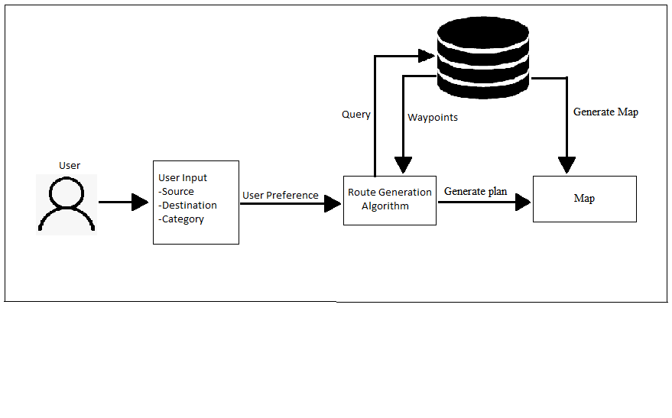
Proposed Architecture Diagram
Proposed Methodology
Figure 1: Proposed Architecture Diagram
5/24/2023
‹#›

Slide 9
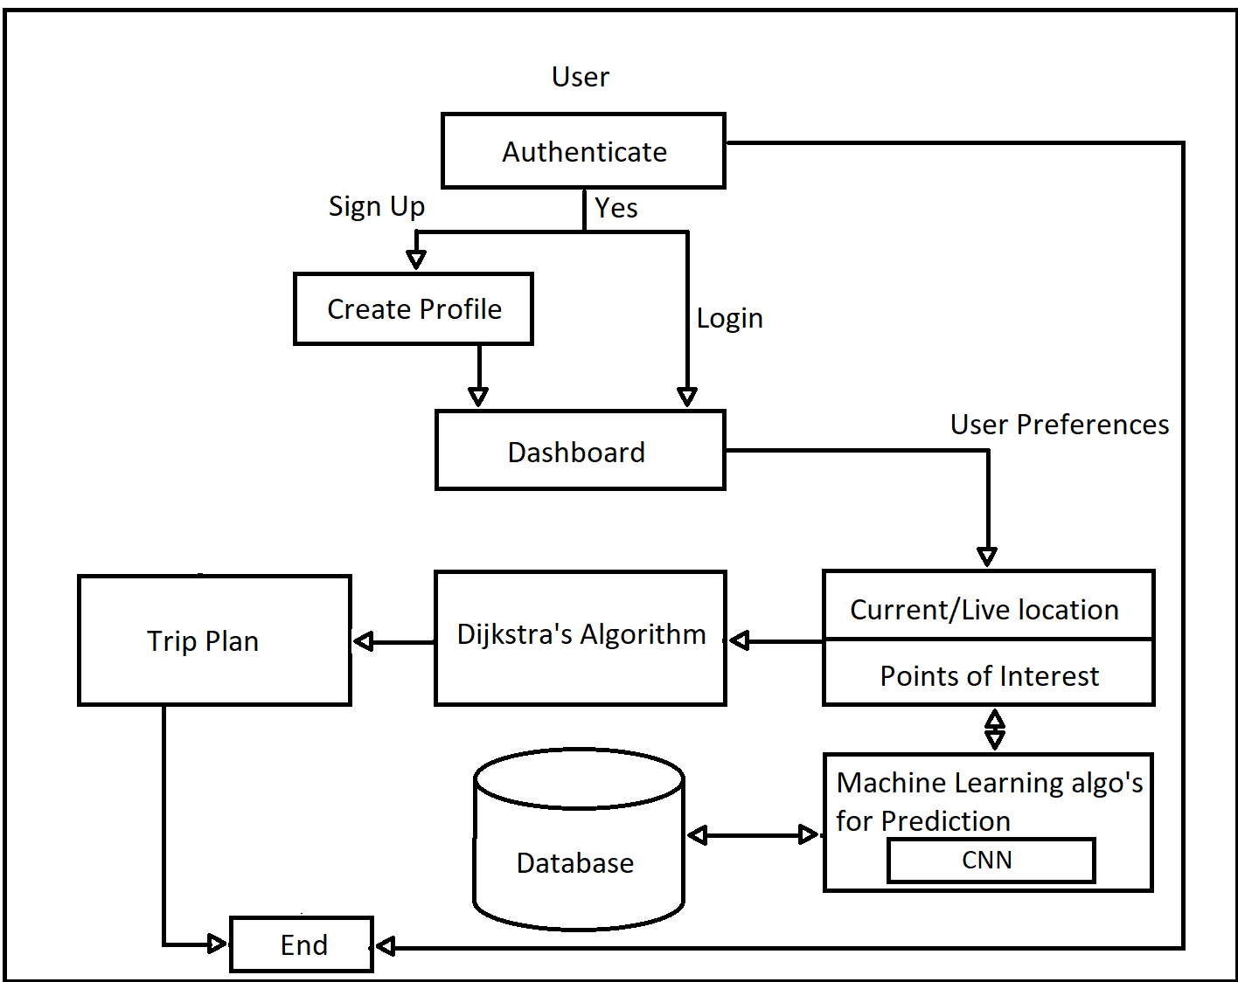
Data Flow Diagram
Figure 2: Data Flow Diagram
5/24/2023
‹#›

Slide 10
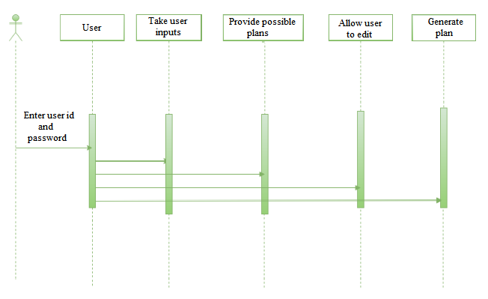
Sequence Diagram
Figure 3: Sequence Diagram
5/24/2023
‹#›

Slide 11
Implementation
Admin Module :
The admin module is a backend interface that enables authorized administrators to manage user accounts, handle data, configure machine learning algorithms, monitor system performance, customize recommendations, manage feedback and reviews, generate reports and analytics, and configure system settings. It serves as a centralized control panel for efficiently managing and maintaining the recommendation system, ensuring its optimal operation, and adapting it to changing requirements.
5/24/2023
‹#›

Slide 12
User Authentication Module :
The user authentication module provides the necessary mechanisms for securely authenticating and managing user accounts within the system. It includes features such as user registration, login, and password management, as well as authentication protocols and encryption methods to ensure the privacy and integrity of user data. This module allows users to securely access the recommendation system, personalize their preferences, and receive tailored recommendations based on their authenticated profile, enhancing the overall user experience and system security.
5/24/2023
‹#›

Slide 13
Tourism Dataset Module :
The tourism dataset module is responsible for handling and processing the relevant data required for the recommendation system. It includes functionalities such as collecting and curating tourism datasets from various sources, performing data cleaning and preprocessing tasks, integrating additional relevant data, and ensuring the dataset's quality and accuracy. This module serves as the foundation for training the machine learning algorithms and generating accurate and personalized recommendations for users based on the rich tourism data available.
5/24/2023
‹#›

Slide 14
Advantages and Disadvantages
Advantages:
Personalized Recommendations
Increased User Engagement
Time-Saving
Improved Business Outcomes
Scalability
5/24/2023
‹#›

Slide 15
Disadvantages:
Data Quality
Lack of Transparency
Limited Diversity
Security Concerns
Resource-Intensive
5/24/2023
‹#›

Slide 16
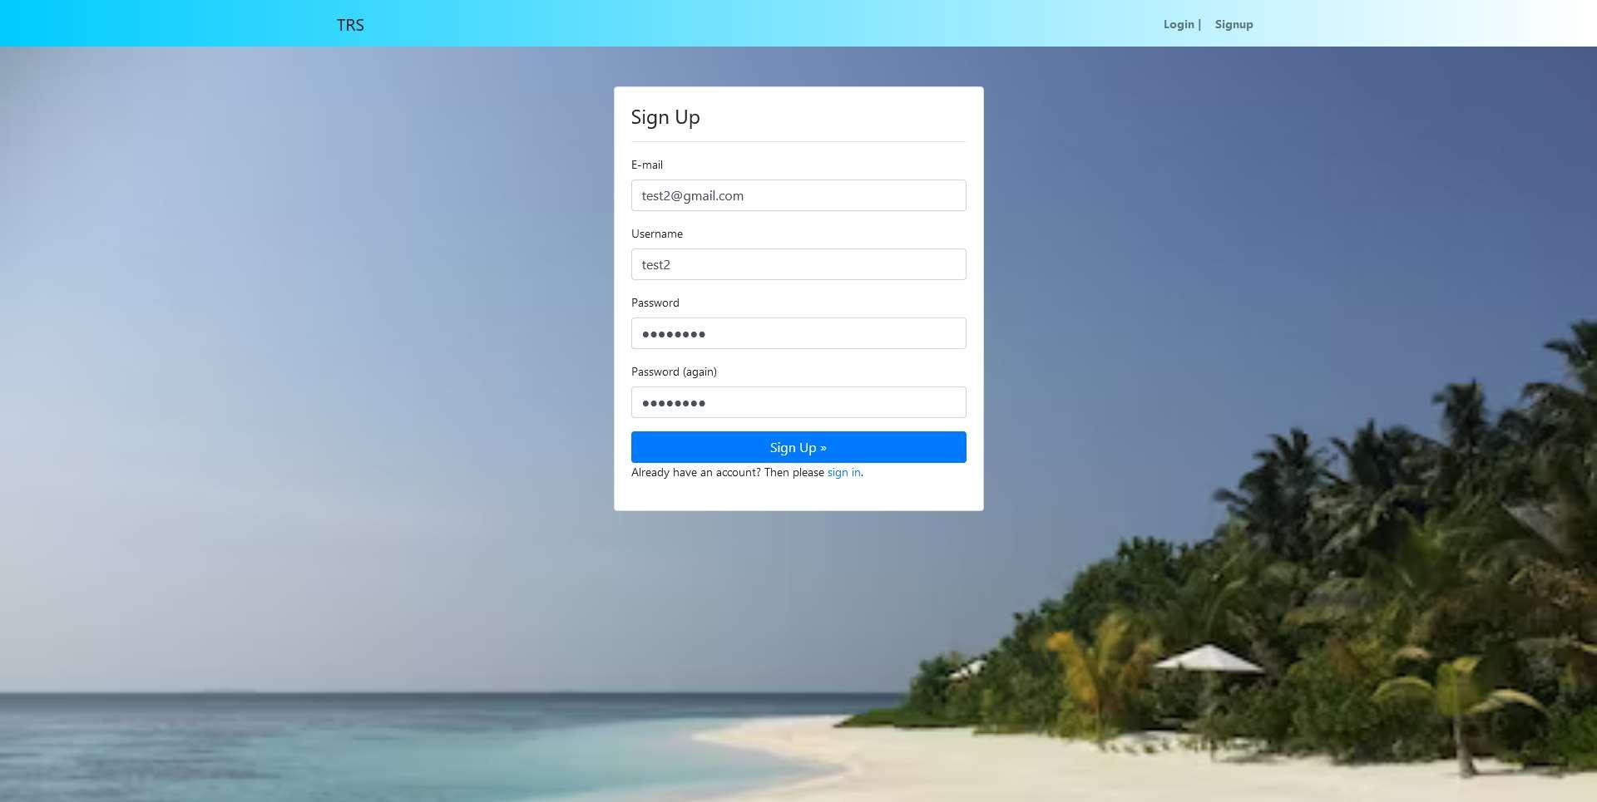
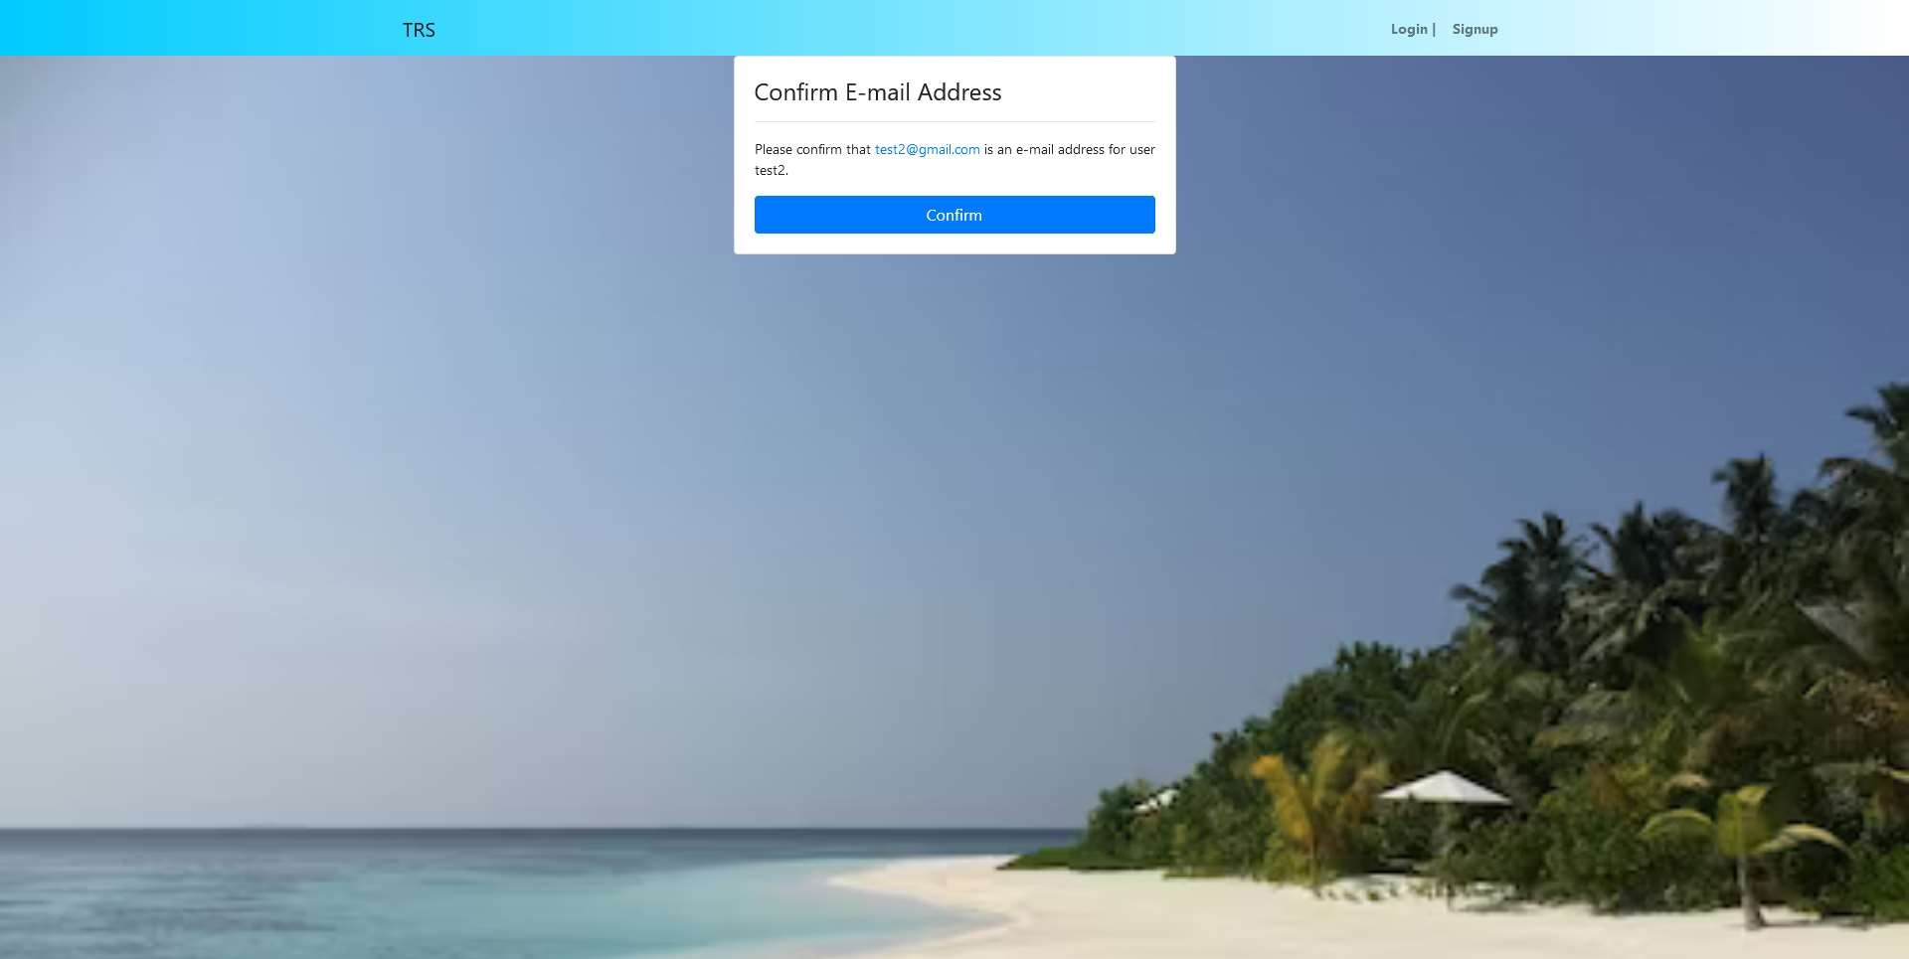
Results and Snapshots
Sign Up Page
Email Confirmation
5/24/2023
‹#›

Slide 17
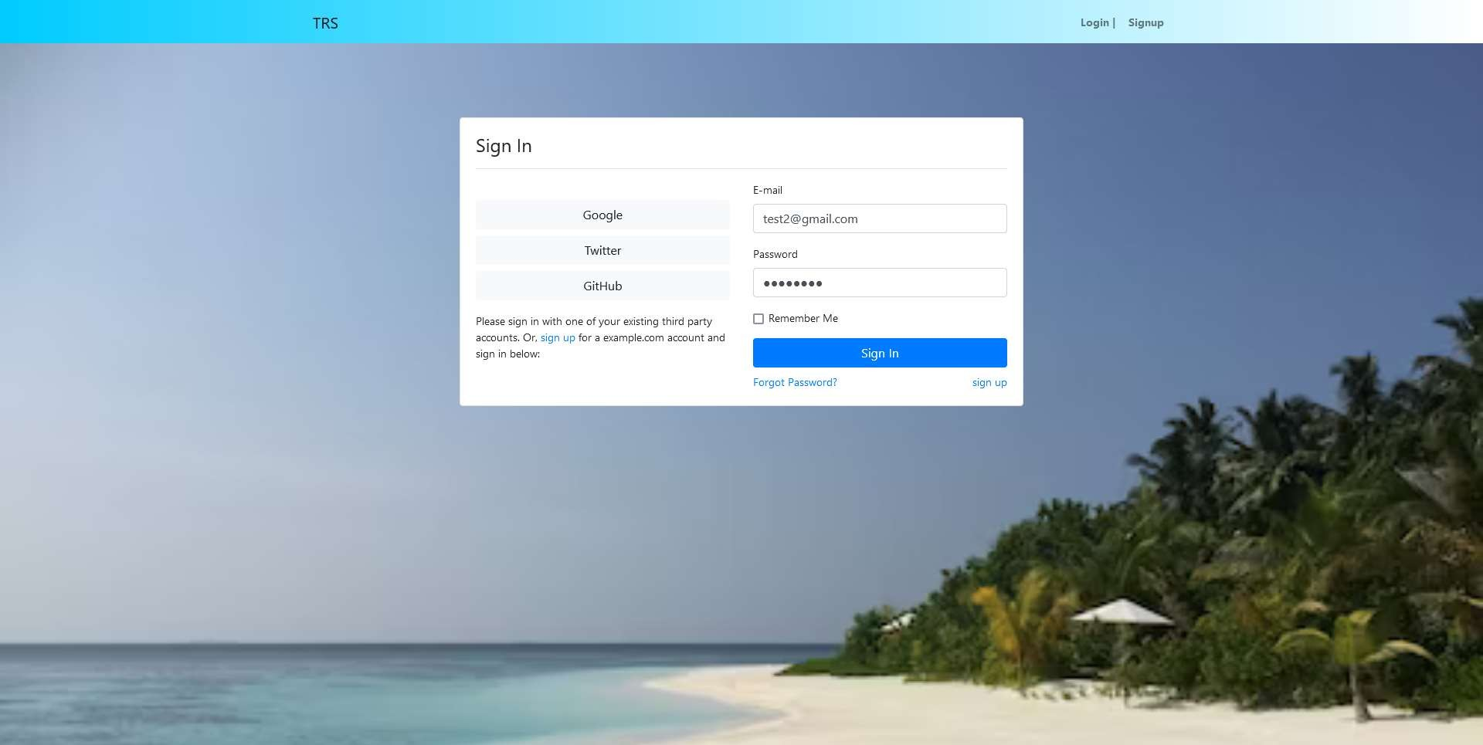
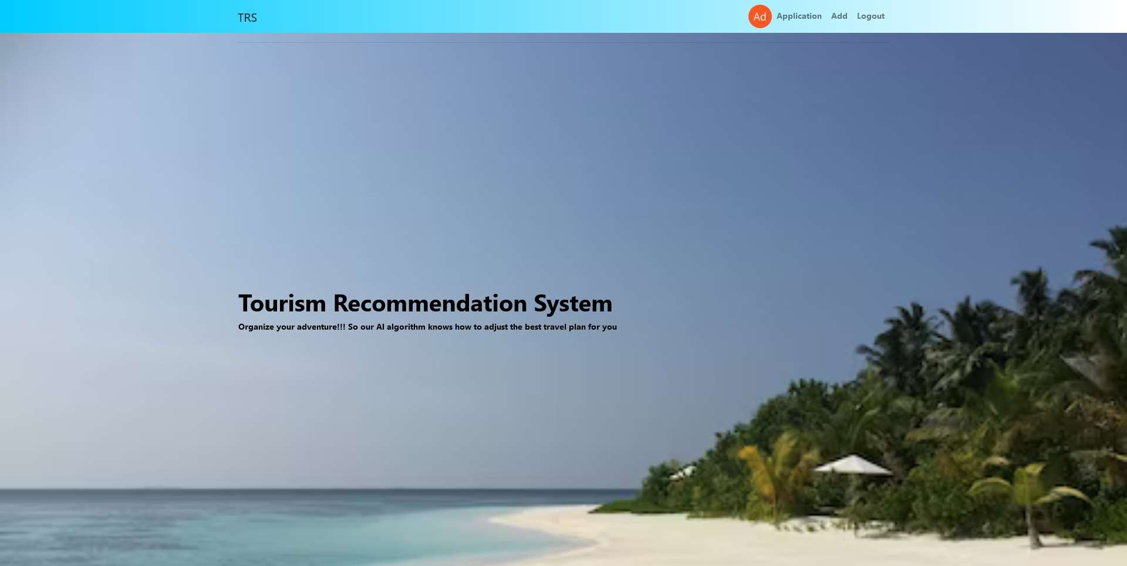
Results and Snapshots
Sign in Page
Home Page
5/24/2023
‹#›

Slide 18
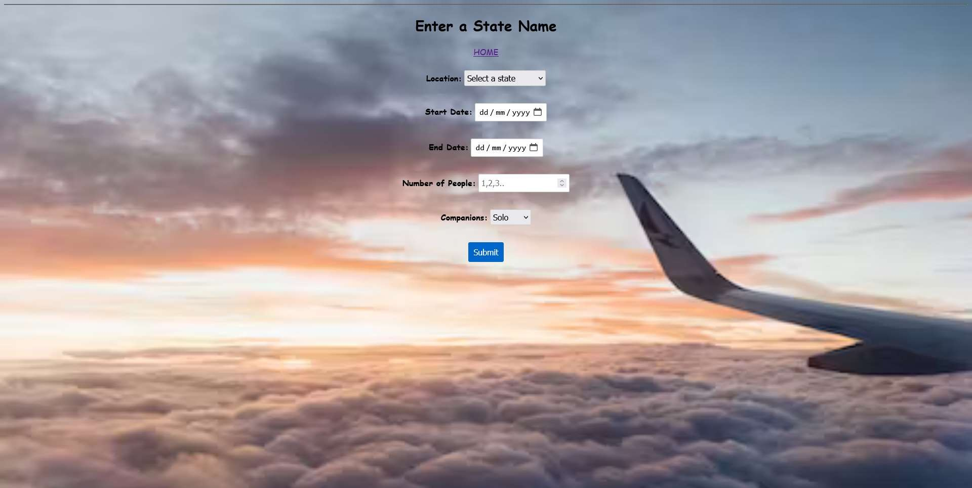
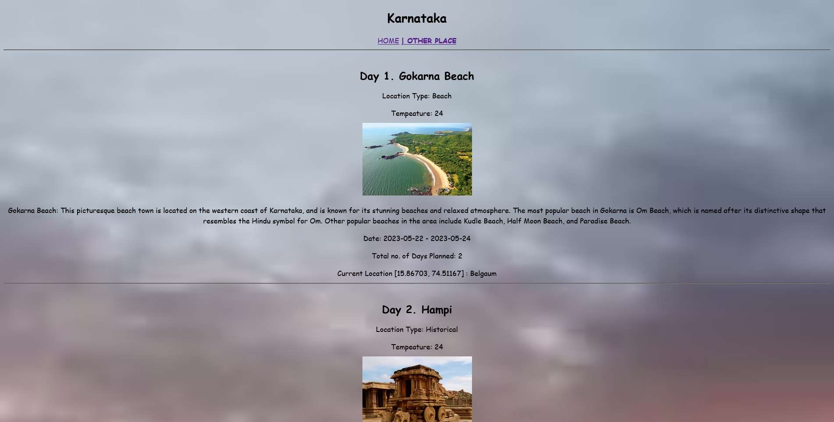
Results and Snapshots
User Input
Generated Plan
5/24/2023
‹#›

Slide 19
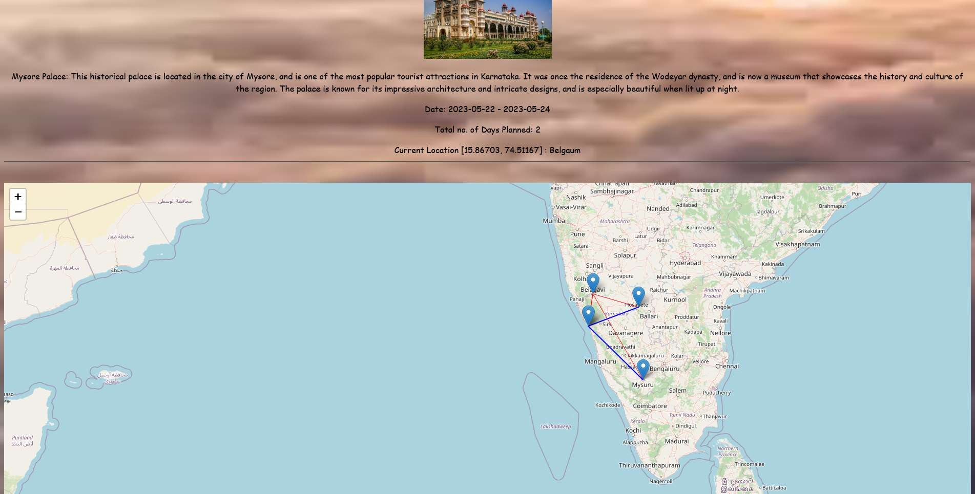
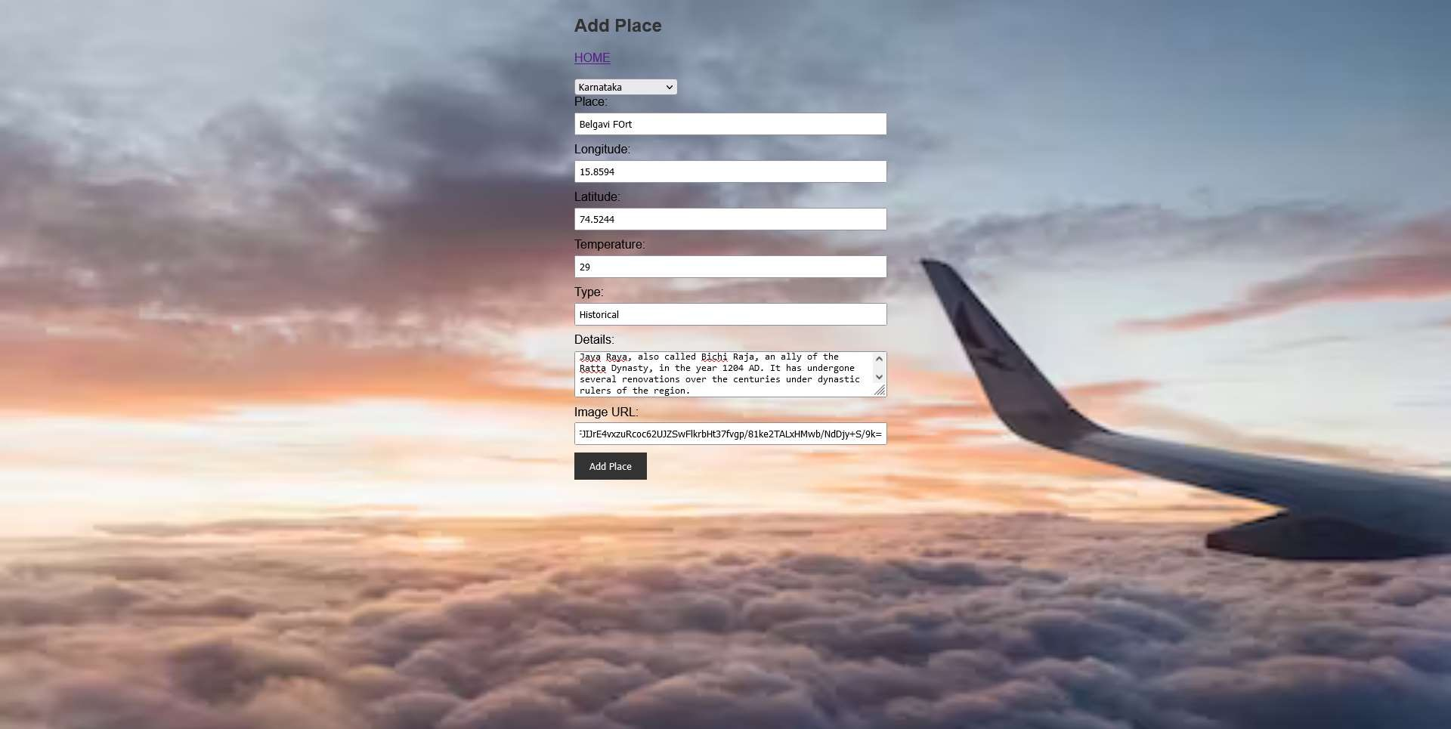
Results and Snapshots
Route Generation on Map
Admin Page
5/24/2023
‹#›

Slide 20
Conclusion
In conclusion, a tourism recommendation system based on machine learning has many advantages but also some minor disadvantages as well. To overcome these challenges, it is essential to design and implement the recommendation system with proper attention to data quality, model design, and system security. Additionally, transparency and diversity in recommendations can be improved by incorporating user feedback and considering alternative recommendation approaches.
Overall, a well-designed tourism recommendation system based on machine learning has the potential to provide significant benefits to both travelers and travel companies, making it a promising technology for the tourism industry.
5/24/2023
‹#›

Slide 21
References
[1] Machine Learning Based Short-Term Travel Time Prediction (2021) by Bo Qiu and Wei (David)
[2] Machine Learning Tourism Prediction System (2020) by Bilal Adualgalil, Sajimon Abraham
[3] Machine Learning Algorithms for building Recommender Systems by Richa Sharma
[4] Deep Learning based Tourism recommendation system by Ismat Fathima Research
[5] Tourism Recommender System using Machine Learning by Charnsak Srisawatsakul
[6] https://dl.acm.org/doi/10.1145/3383972.3384074
[7]https://www.researchgate.net/publication/333857452_A_Machine_Learning_Approach_to_Building_a_Tourism_Recommendation_System_using_Sentiment_Analysis
[8] https://www.sciencedirect.com/science/article/pii/S2212017314004848
5/24/2023
‹#›
*

Slide 22
THANK YOU
*
‹#›

